Slide 1
Good Morning!
Name the 3 main structural components of Chymotrypsin, briefly Id their action

Slide 2
Learning Objectives ch 9
Chymotrypsin/serine proteases (9.1)
Carbonic Anhydrase (9.2)
Restriction Endonucleases (9.3)
General reaction (one for each of the above)
Key components of the active site
How is specificity regulated
Mechanism of action
Importance of key cofactors
Thermodynamics and Kinetics
Biological relevance
Key experiments that lead to understanding of the above

Slide 3
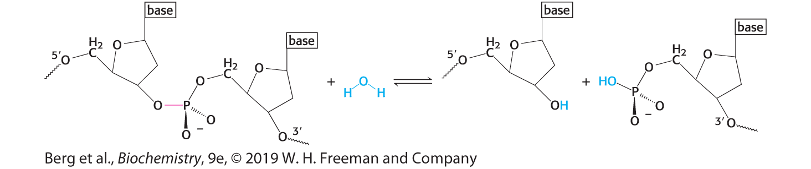
Restriction Endonucleases: Very specific rxn sites
Focus on Type II restriction enzymes:
cleave within a specific recognition sequence/site
Two major considerations:
Mechanism
How not to cleave the host DNA

Slide 4
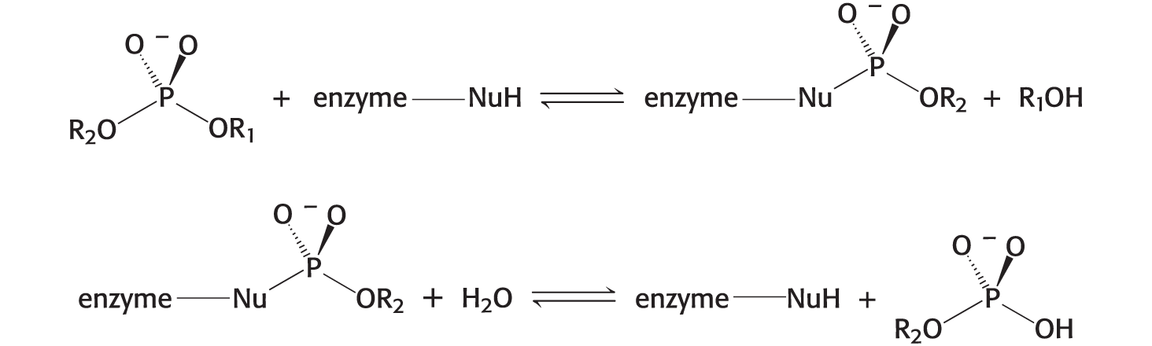

2 possible Mechanisms of cleavage
Mechanism 1 (covalent intermediate):
Mechanism 2 (direct hydrolysis):

Slide 5
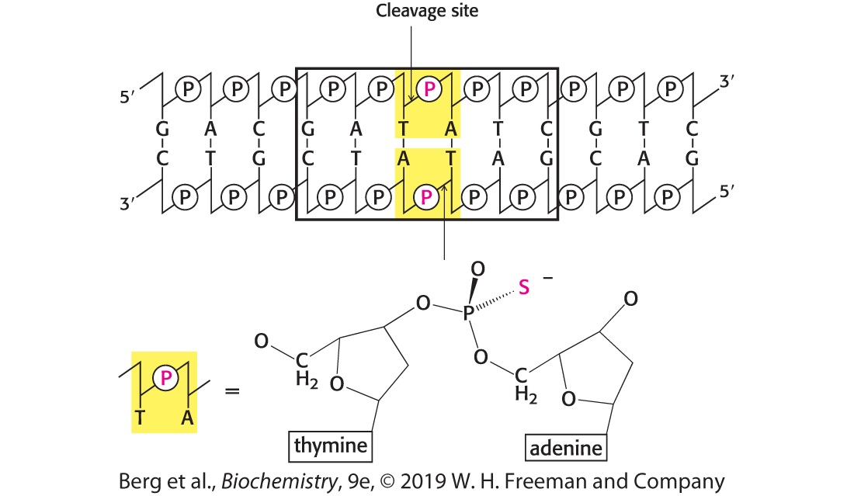
Determination of mechanism using Phosphorothioates

Slide 6
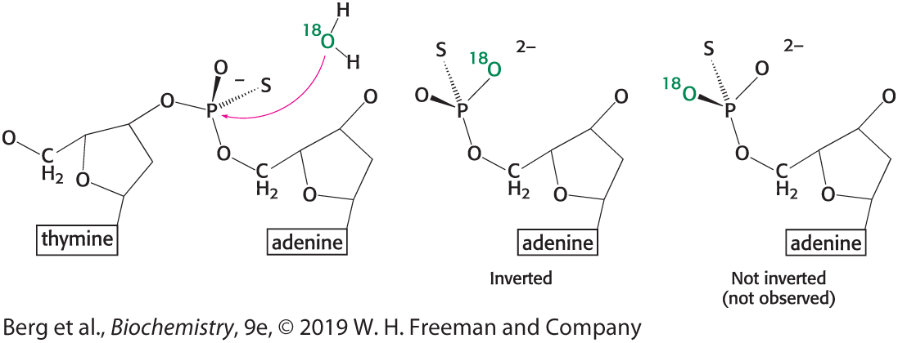
Stereochemistry of Cleaved DNA

Slide 7
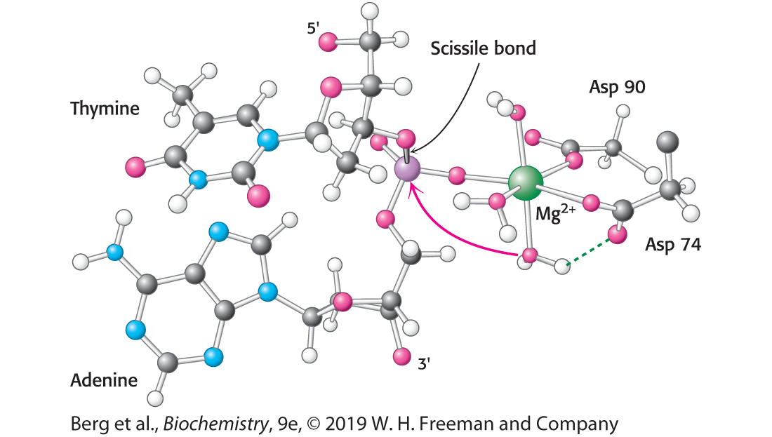
Mg²⁺ is Required for Catalysis

Slide 8
The problem of host specificity
Palindromic Sequence of EcoRV is 5’GAT\ATC3’
6 bp sequence, 4⁶ = 4096. 4K x more sequences we don’t want cleaved

Slide 9
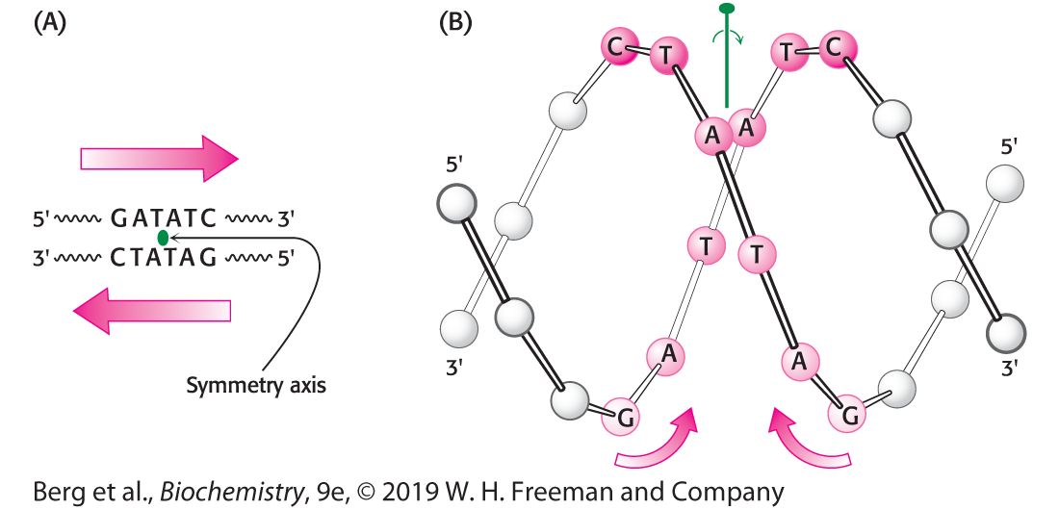
2-Fold symmetry @ EcoRV Recognition Site

Slide 10
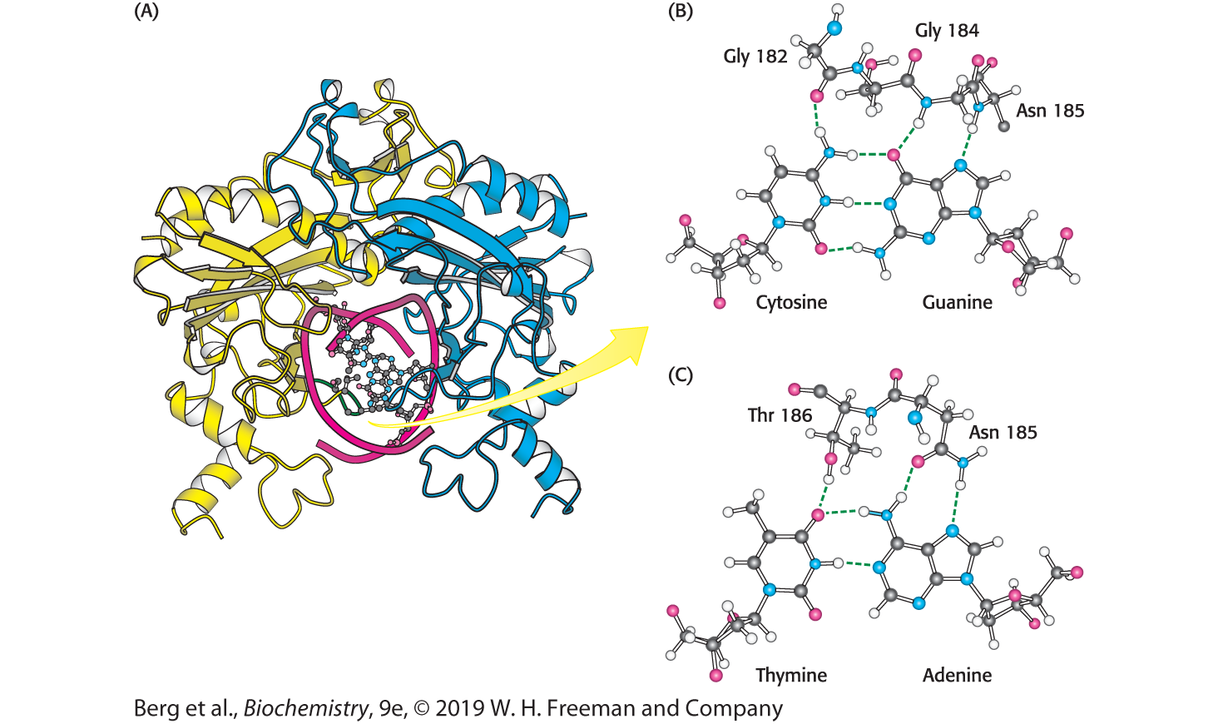
EcoRV Embracing a Cognate DNA Molecule

Slide 11
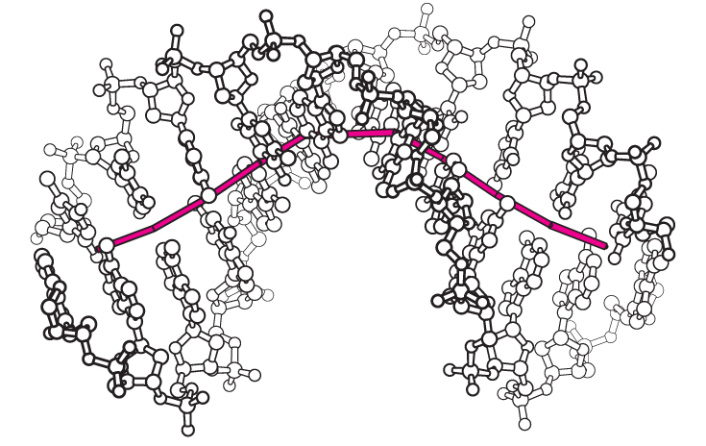
DNA Distortion allows assembly

Slide 12
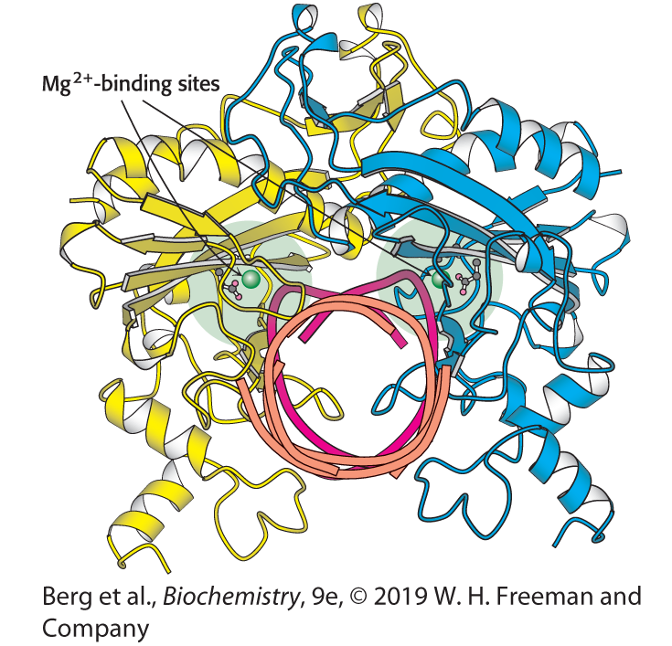
Distortion is specific for Cognate DNA
Sequences
Orange = noncognate
Red = cognate

Slide 13
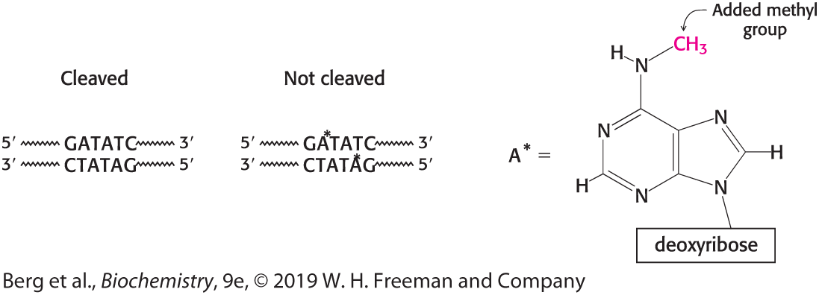
Bacteria Methylate their DNA

Slide 14
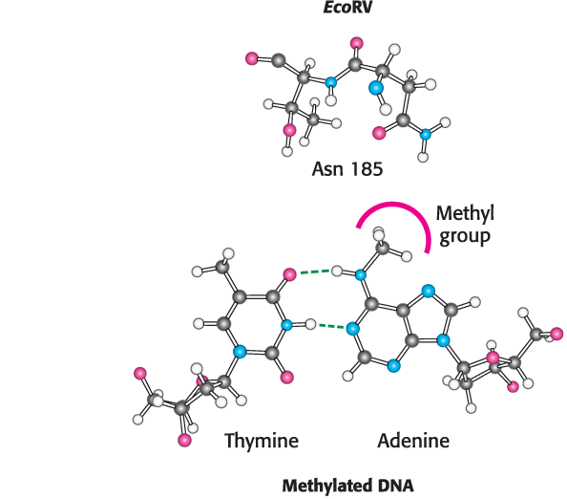
Methylation blocks Hbonds

